Slide 1
Automatic Knowledge Base Construction With LLMs For Amplifiers Datasheets
Presented By: Vaibhav R Khandekar
Guided By: Dr. Frank Wawrzik

Slide 2
Overview
Introduction
Related Concepts
Data Extraction & Data cleaning
Prompt Engineering
Triplet Extraction
Construction of Amplifier Ontology
Owlready2
Conclusion

Slide 3
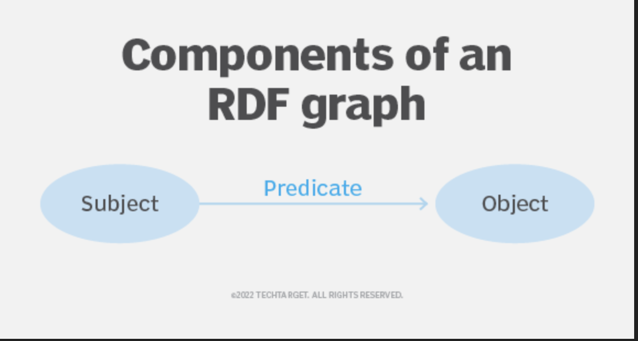
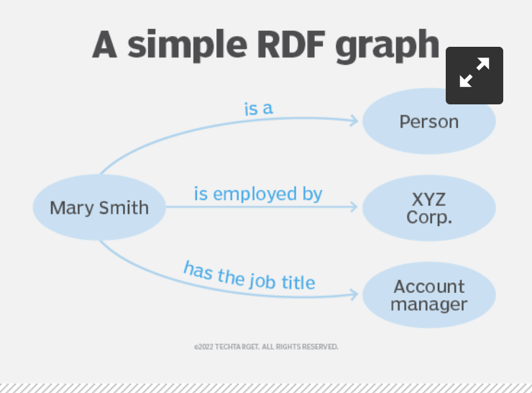
Introduction
The goal is to introduce the automation while creating the ontology file.
Ontology: It explores questions about what exists and how entities relate to each other in specific domain[2]
GENIAL: Basic ontology containing necessary terms for modelling cars components, properties, functions and dependencies along the automotive value chain[3].
The same entities and relations structure from GENIAL has been used
LLMs: Large language models designed to understand and generate human like texts.
LLMs can enhance Knowledge Graph construction by aiding in knowledge extraction and improving overall quality.

Slide 4
Introduction
Knowledge Graphs: are networks that represent data in a graphical format.
Representation of concepts, events and entities as nodes, and the relationships between them as edges.
However, KG has difficult, costly and time-consuming construction process.
There is growing interest in integrating LLMs like Gemini, GPT-4 into the construction process
GEMINI: a powerful multimodal model LLM developed by Google AI.
Based on Transformer architecture[4], a NN designed specifically optimized for NLP tasks.
Employs a parallel approach, allowing it to analyse the entire context of a sentence simultaneously.
several optimizations includes scaling to massive datasets, Google's custom hardware(TPU’s), multimodal capabilities[1].

Slide 5
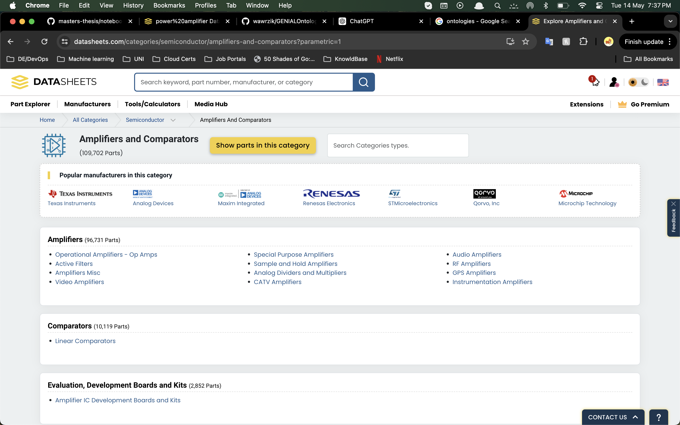
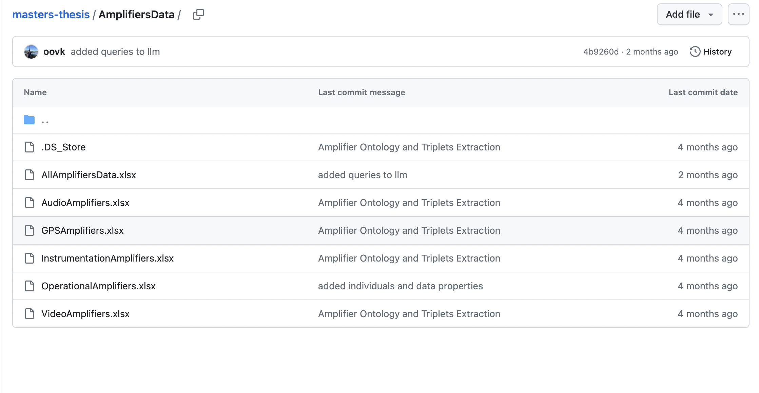
Data Extraction & Cleaning
It is difficult to extract the electrical characteristics table from the component’s pdf since each pdf structured differently
To make my approach more scalable, I’ve used I have used the data from following a website. https://www.datasheets.com/categories?parametric=1
It has different types of amplifiers, and their electrical characteristics in tabular form.
Data is downloaded for different types of amplifiers
The downloaded data is cleaned and converted to CSV so that LLM can understand it well

Slide 6
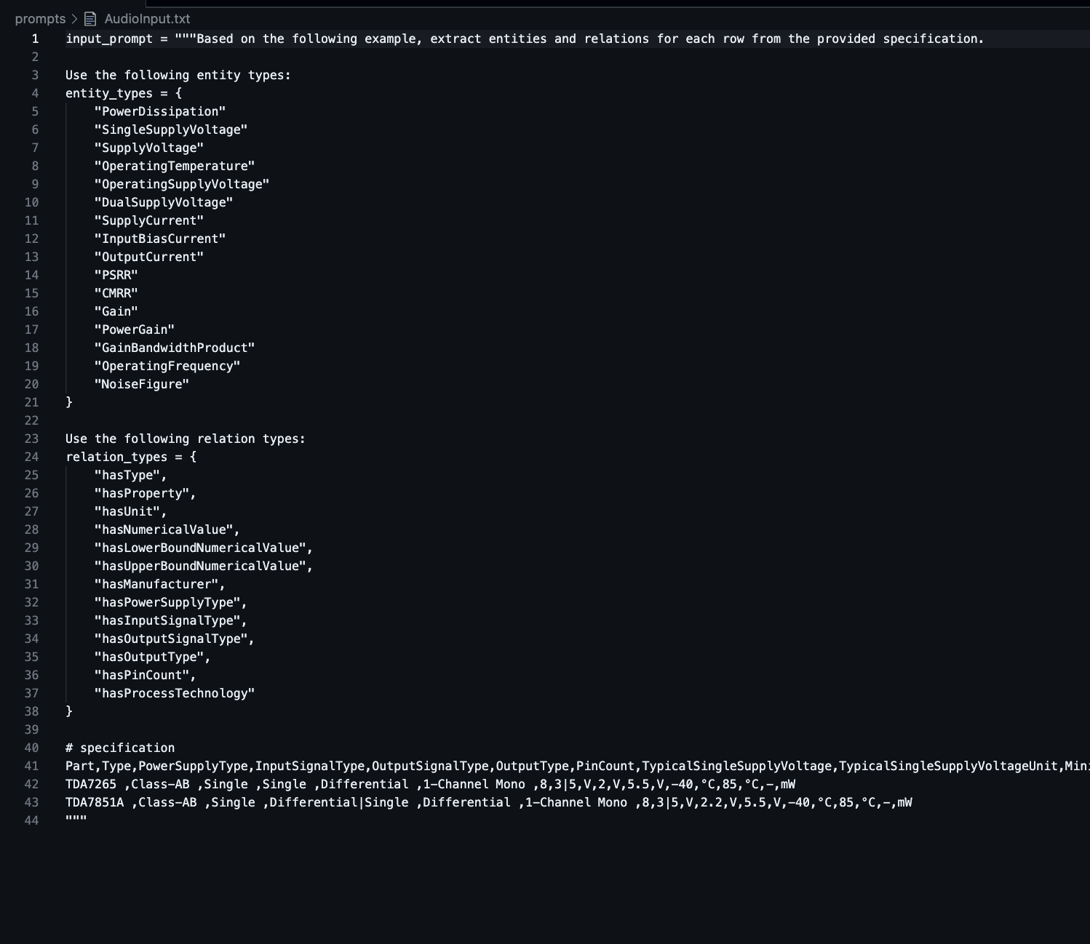
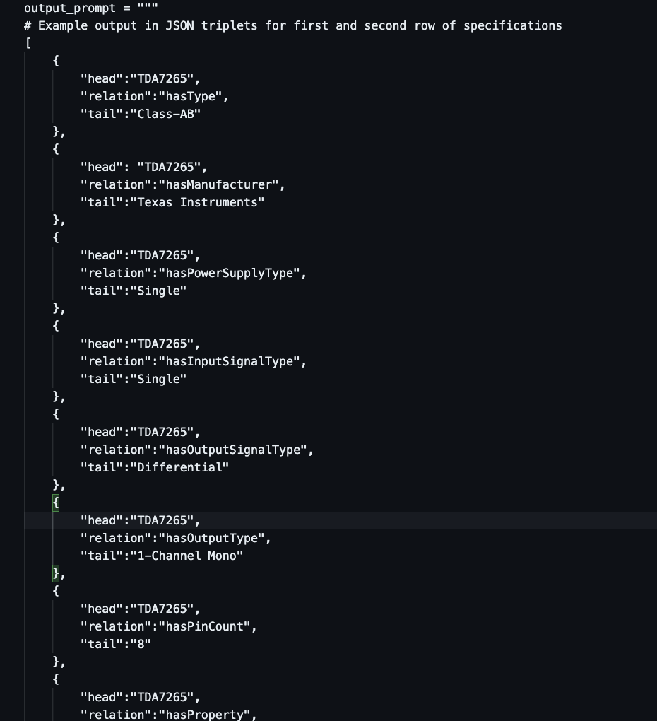
Prompt Engineering
Definition: formulating precise, effective, and contextually relevant prompts to elicit desired responses from the model[8].
Different prompt are created for each amplifier types, since electrical characteristics differ for each of them.
Input Prompt: Contains the text description, entity & relation type, example data provided
Output Prompt: Contains output format in JSON that we expect from LLM. { Head, Relation, Tail }
https://github.com/oovk/masters-thesis/tree/main/prompts

Slide 7
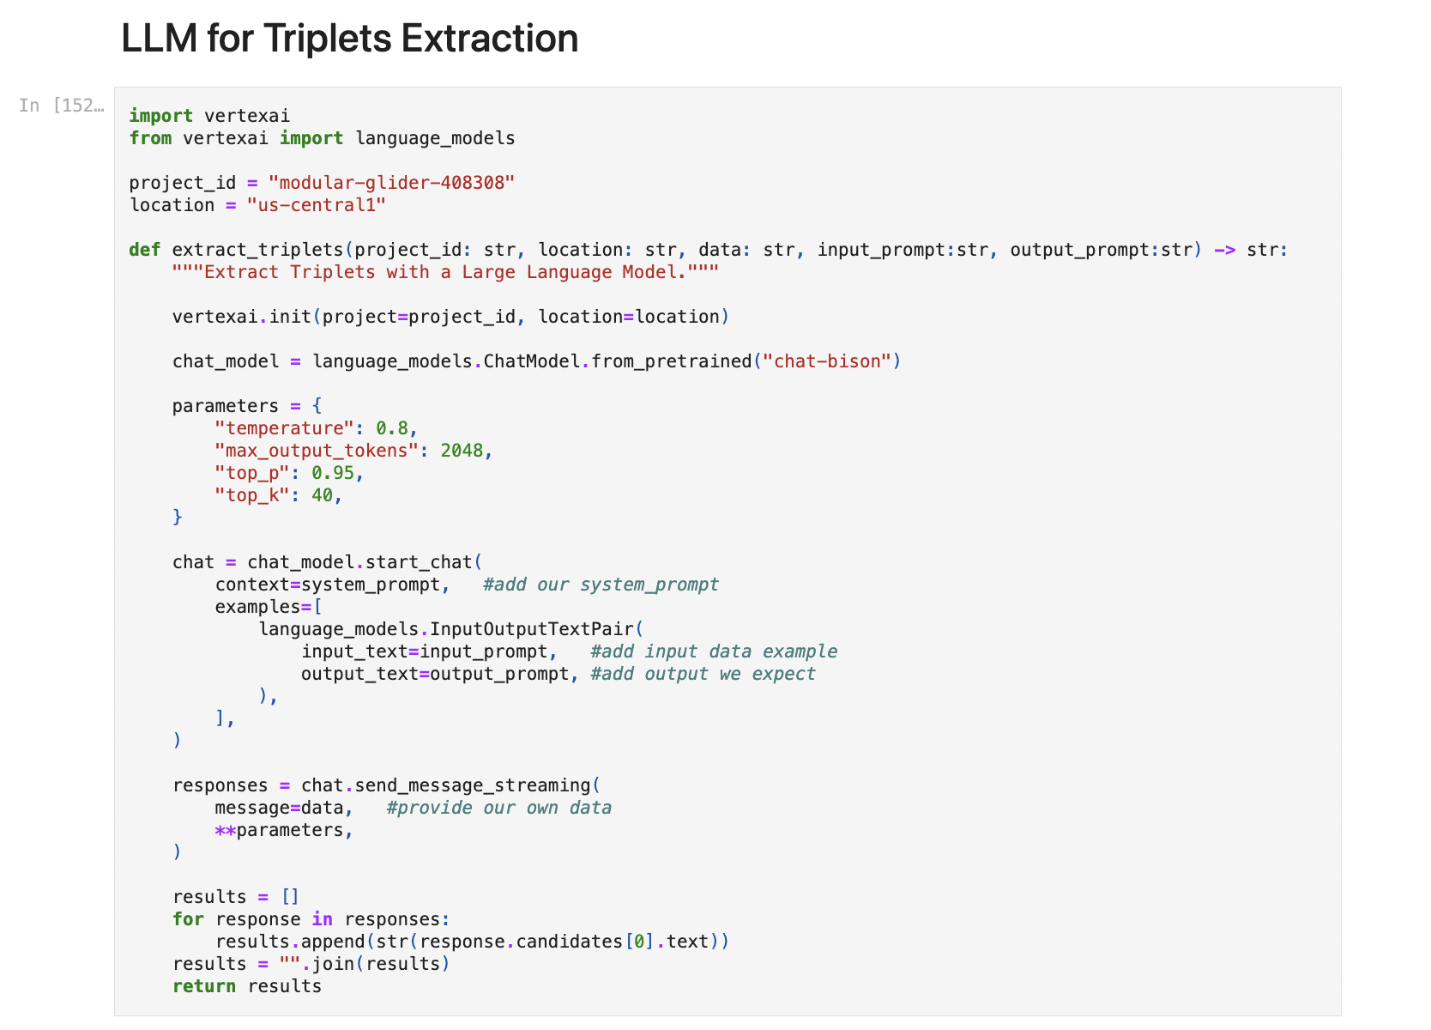
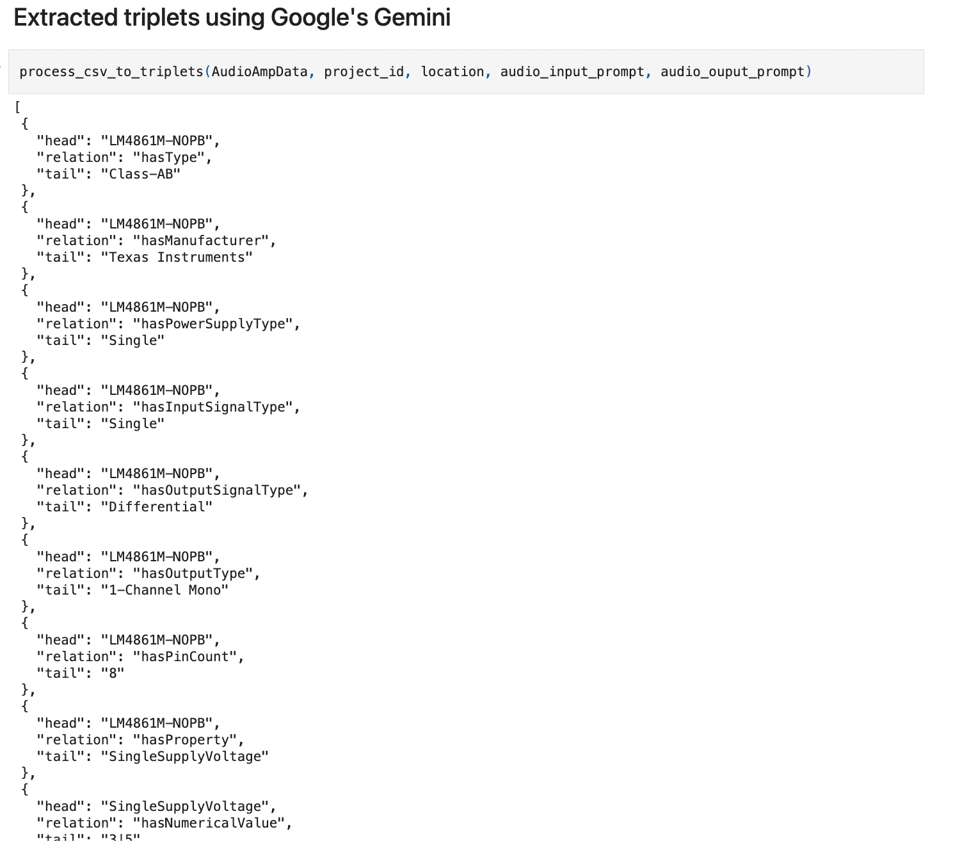
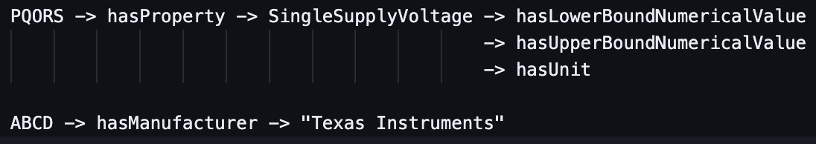
Triplet Extraction with Gemini
The retrieved data and the respective prompts are passed to LLM API[1].
LLM(Gemini API) returns the Triplets containing head, relation, tail.
These triplets are in same format as provided in prompts.
Triplets are saved in JSON.
https://github.com/oovk/masters-thesis/blob/main/notebooks/Thesis.ipynb

Slide 8
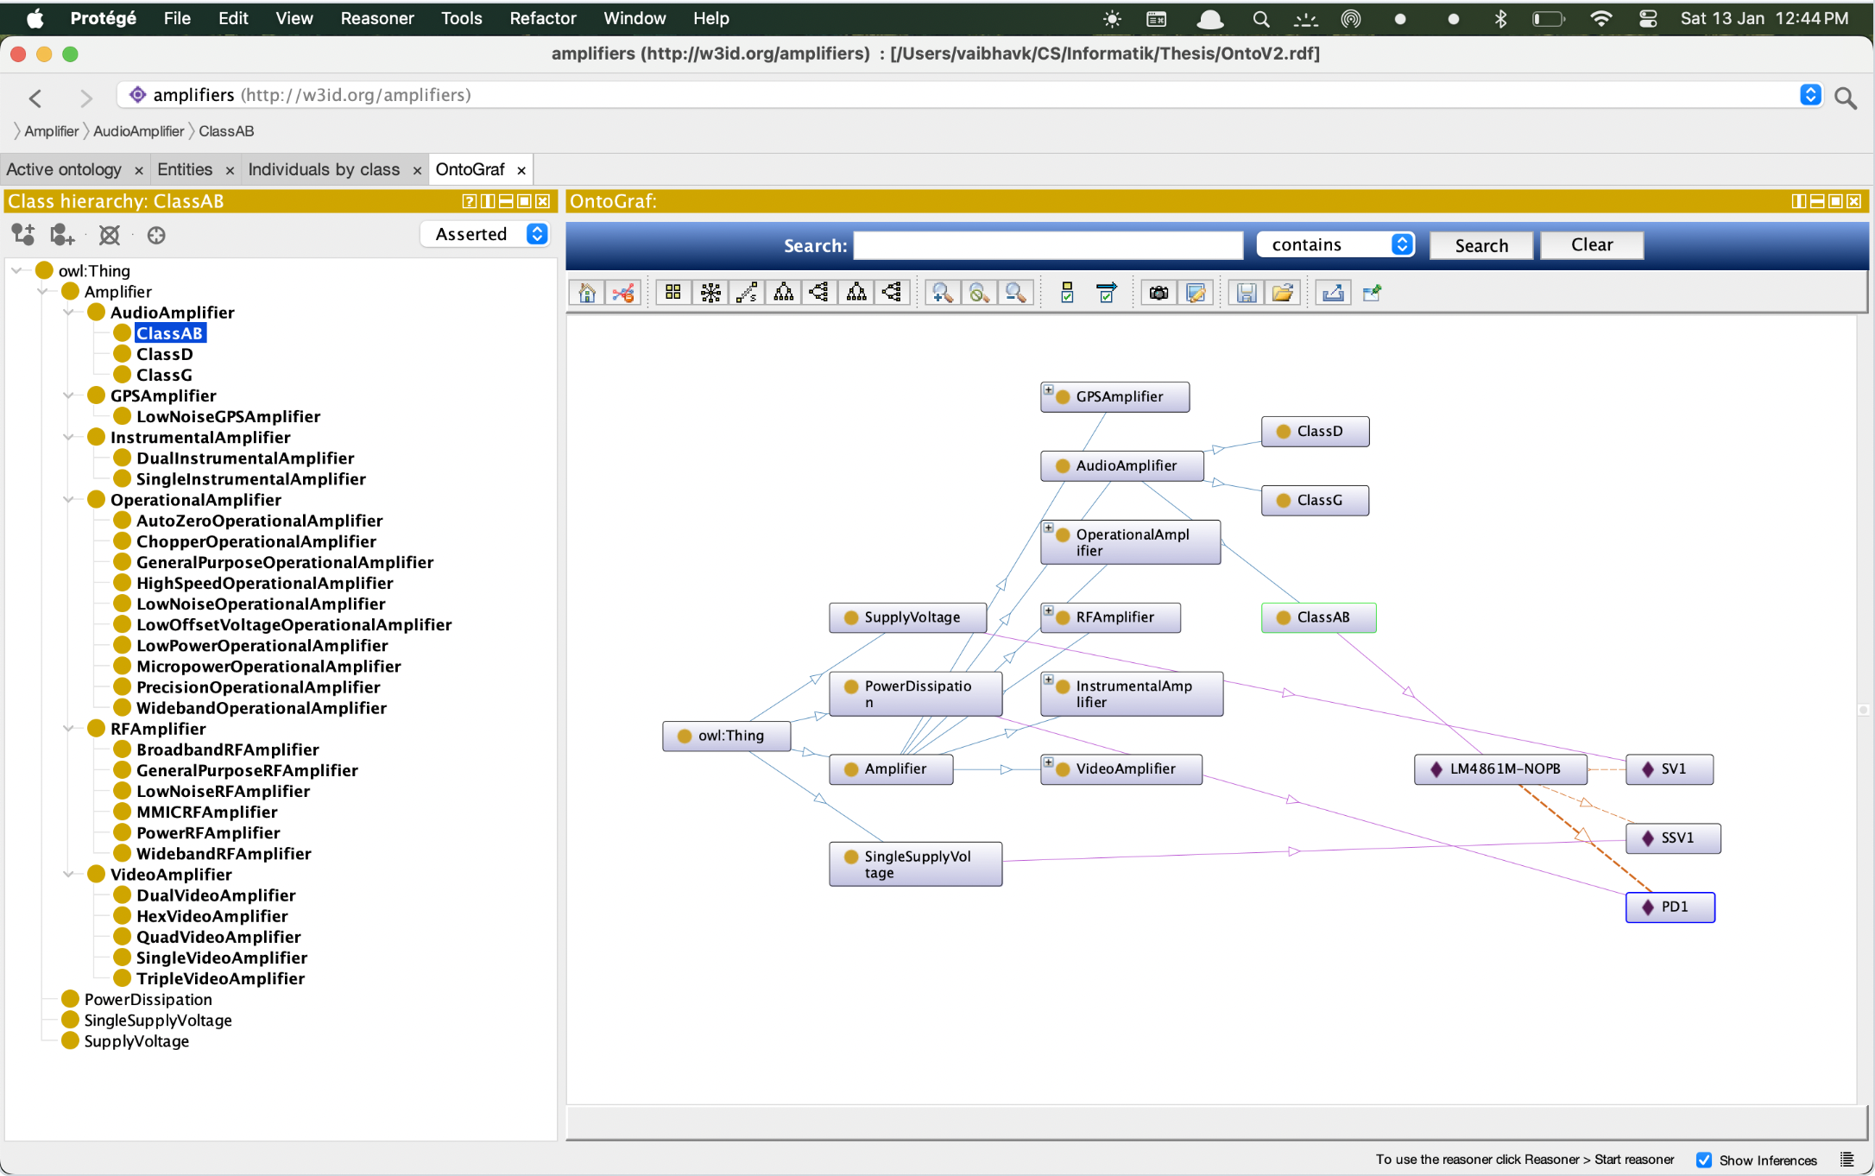
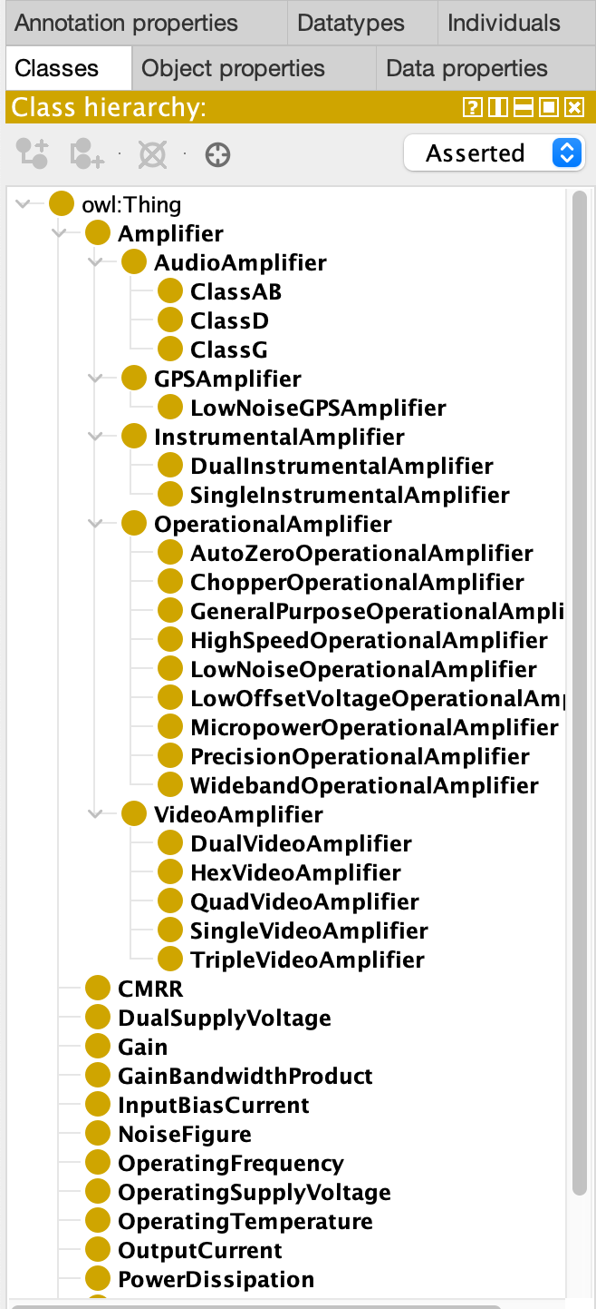
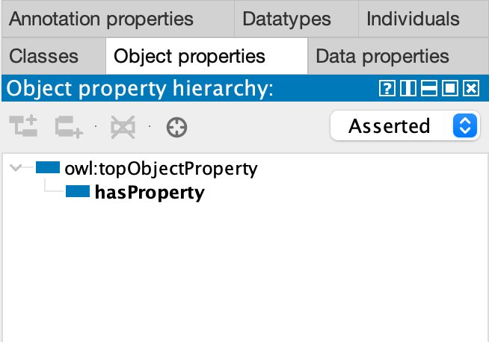
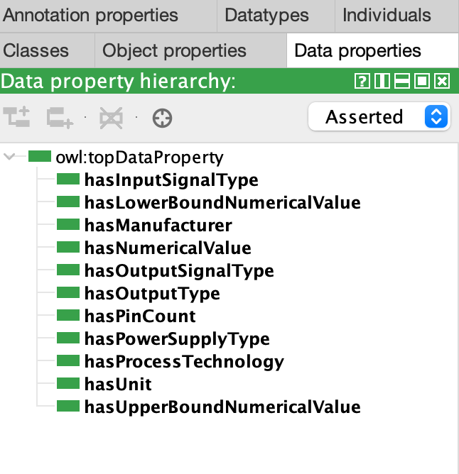
Construction of Ontology
The ontology[2] is constructed keeping the entities and relations from GENIAL in mind.
The overall structure of classes and subclasses, data and object properties are created.
Further the constraints and restrictions are added to ensure the consistency, coherence and integrity.
https://owlready2.readthedocs.io/en/latest/index.html
https://github.com/oovk/masters-thesis/blob/main/OntoFiles/AmpKB.rdf

Slide 9
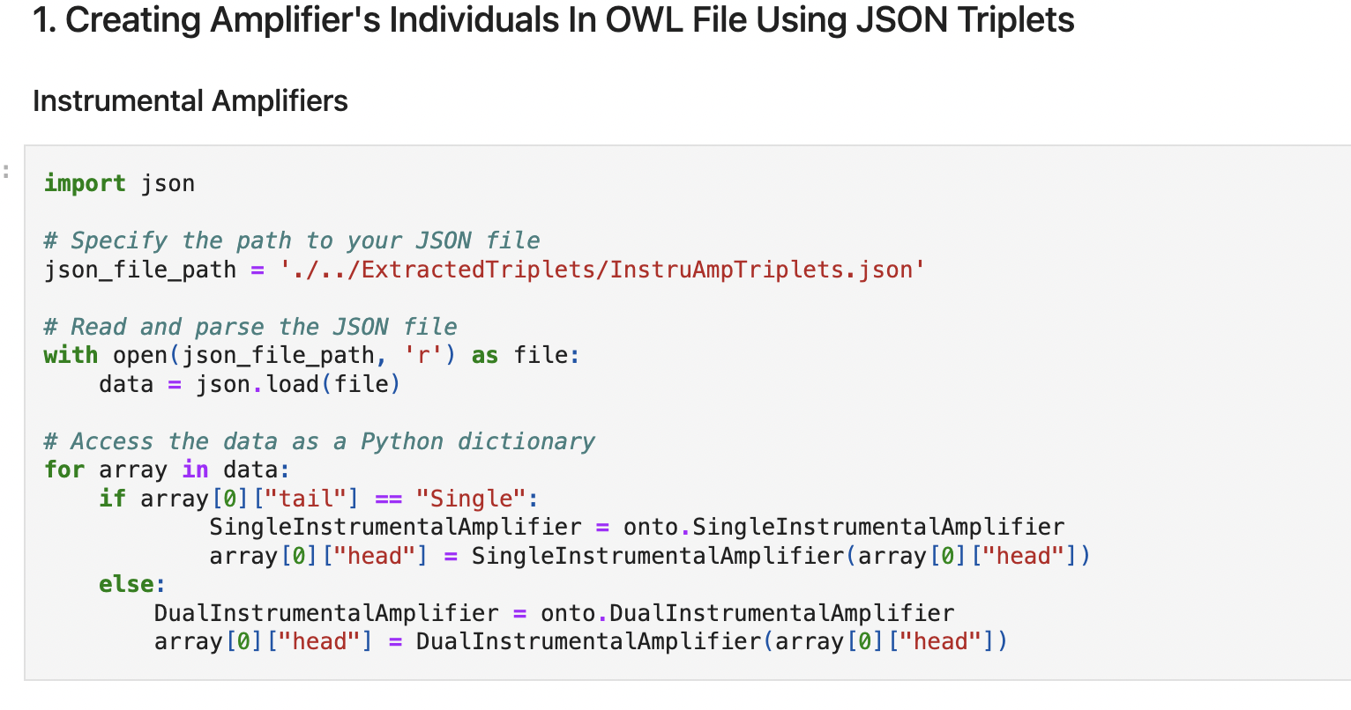
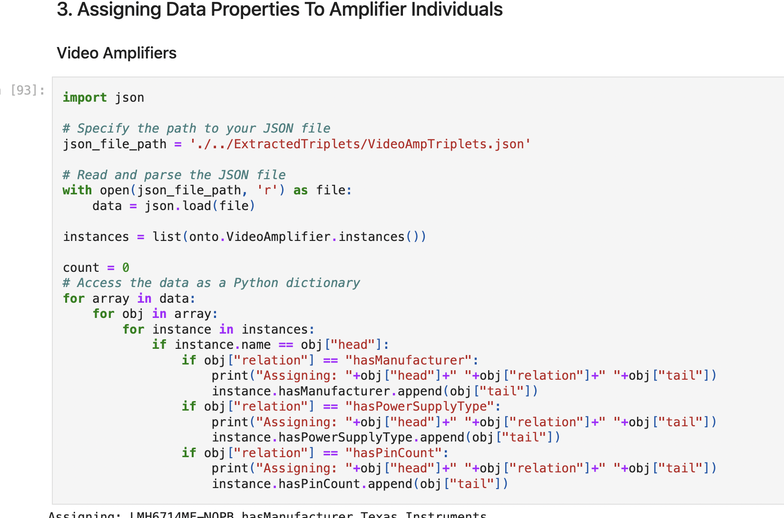
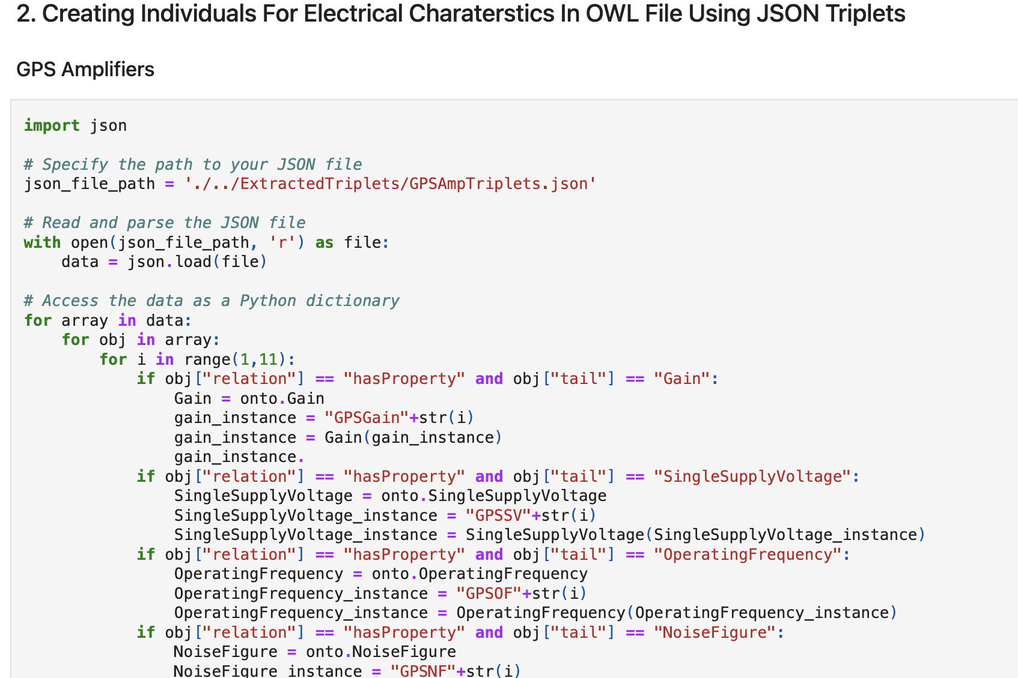
Owlready2
Owlready2[5] is python package used to modify owl 2.0 ontologies in python.
Allows us to load, modify, save owl files.
As a final step owl file is loaded using owlready2 and various amplifiers are added as individuals to classes.
Further consistency and inference of knowledge base is checked using reasoner and SPARQL queries.
https://github.com/oovk/masters-thesis/blob/main/notebooks/Thesis.ipynb

Slide 10
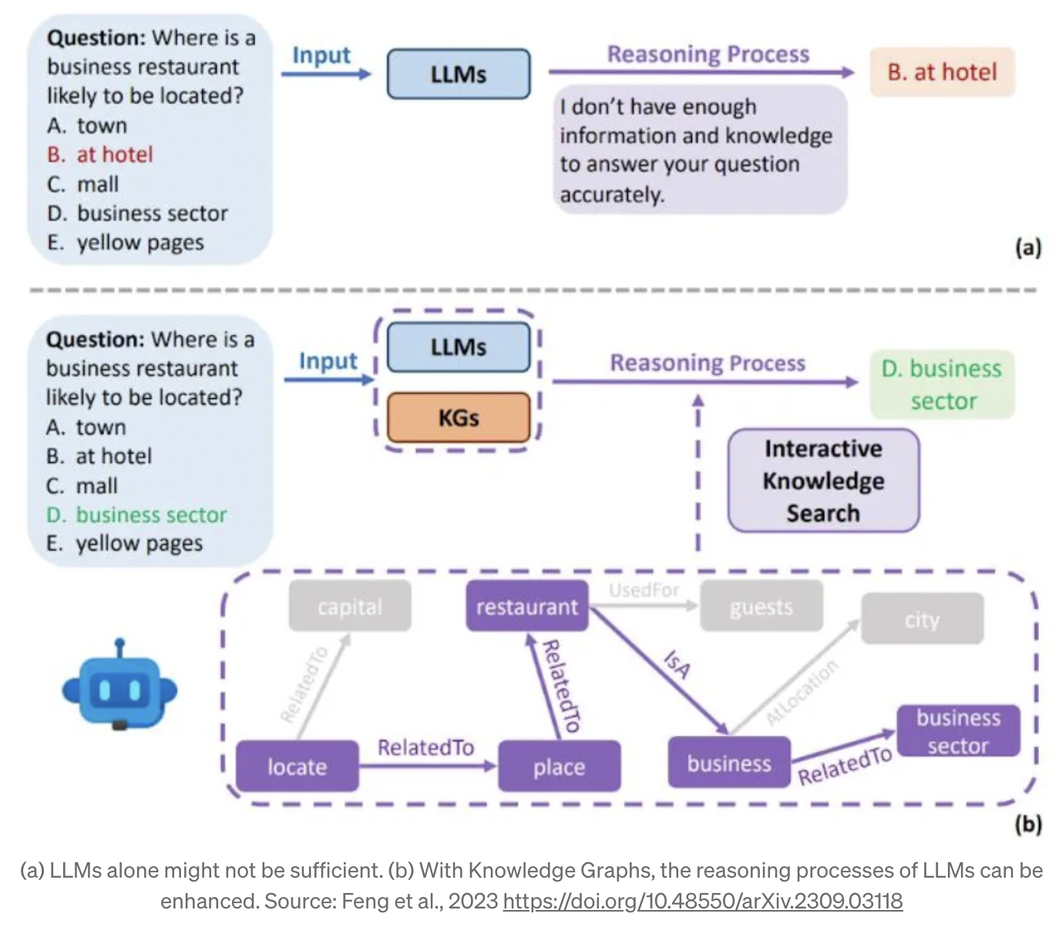
Conclusion
Using LLM and owlready2 allows us to make the process of creating knowledge base automatic.
LLMs can extract knowledge from data to populate a Knowledge Graph
Using owlready2, individuals can be created in bulk and assigning them values
Performance comparison of SPARQL queries and LLMs
Observed that, As LLMs are trained on large datasets, this makes LLMs static
LLMs suffers challenges such as hallucination, lack of domain knowledge, limited reasoning abilities as well as bias, privacy and toxicity
Future Work: RAGs, LLMs for automatic Knowledge Graph construction, Enhancing LLM reasoning with Knowledge Graphs

Slide 11
References
Gemini Team, Rohan Anil, Sebastian Borgeaud, YonghuiWu, Jean-Baptiste Alayrac, Jiahui Yu, Radu Soricut, Johan Schalkwyk, Andrew M Dai, Anja Hauth, et al. Gemini: a family of highly capable multimodal models. arXiv preprint arXiv:2312.11805, 2023.
Wikipedia contributors. Ontology. https://en.wikipedia.org/wiki/Ontology, 2022. [Online; accessed 13-October-2023].
Frank P Wawrzik and Andreas Lober. A reasoner-challenging ontology from the microelectronics domain. In SemREC@ ISWC, pages 1–12, 2021.
Ashish Vaswani, Noam Shazeer, Niki Parmar, Jakob Uszkoreit, Llion Jones, Aidan N. Gomez, Lukasz Kaiser, and Illia Polosukhin. Attention is all you need, 2023
Jean-Baptiste Lamy. Owlready: Ontology-oriented programming in python with automatic classification and high level constructs for biomedical ontologies. Artificial intelligence in medicine, 80:11–28, 2017.
Linyao Yang, Hongyang Chen, Zhao Li, Xiao Ding, and Xindong Wu. Give us the facts:
Enhancing large language models with knowledge graphs for fact-aware language modeling. IEEE Transactions on Knowledge and Data Engineering, 36(7):3091–3110, 2024.
Andrew Kean Gao. Prompt engineering for large language models. 2023.

Slide 12
Thank You!

